Slide 1


Slide 2


WIRELESS CHARGER
TEAM MEMBERS :
GUIDED BY
Mrs. P.YUVARANI,
ASSISTANT PROFESSER,
ECE DEPARTMENT.
R.SNEHA (927621BEC202)
V.SUJITHA (927621BEC222)
S.SUNMATHI (927621BEC223)
M.YAKSHINI (927621BEC244)

Slide 3
INTRODUCTION :
Smart phones are very popular nowadays. As the usage of these portable electronic devices is increasing, the demand for longer battery life is also increasing. These batteries need to be recharged or replaced periodically. It is a hassle to charge or change the battery after a while, especially when there is no power outlet around. Therefore, our team is inspired to design a wireless battery charger. This wireless battery charger is expected to eliminate all the hassles with today's battery technology. Wireless power transfer through the use of strongly coupled magnetic resonances works very well for efficient midrange power transfer in dynamic environments compared with other power technologies.

Slide 4
COMPONENTS REQUIRED :
Relay
Timer IC
Transistor
Rectifier
LEDs
Resistors
Super capacitors
Toggle Switch

Slide 5
ABSTRACT :
As per the efficiency and functionality is concerned, wireless charging technology has become significantly advanced, still battery is one of the major issue of wireless charging which leads to more time consumption. By collaboration of wireless charging and super capacitor concept, faster charging can be achieved efficiently. This paper explains the idea of the Super capacitor’s stacking scheme to charge the mobile phones wirelessly, as a solution over conventional Lithium ion battery which has lengthy charging cycle, high aging effect and gives out emissions.

Slide 6
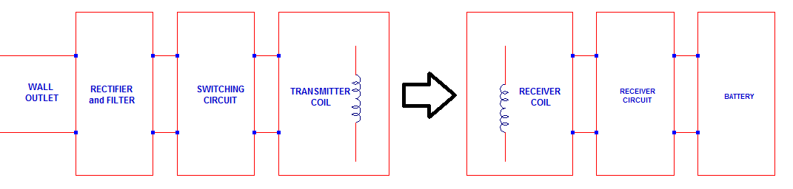
BLOCK DIAGRAM :

Slide 7
WORKING PRINCIPLE :
Complete circuit is divided into two parts, one is transmitter section and other is receiver section. Transmitter section consists of microcontroller to generate the frequency of 40 KHz at which LC tank circuit will oscillate. High frequency is used, because low frequency is not capable to deliver that much of power to the tank circuit. It is not sufficient to oscillate tank circuit. So there is a power MOSFET to amplify the microcontroller output. N-Channel MOSFET is preferred as it has mobility of 1300v/m2. Mobility is directly proportional to amount of current handle by the device (up to 25A output current). Output of power MOSFET is given to LC tank circuit, which consist of capacitor and inductor in parallel. Capacitor stores the energy in the form of electric field and inductor stores the energy in the form of magnetic field .When voltage of 18V 3A appears across the capacitor, it start charging. When it gets fully charged it stops charging from source and starts to discharge through inductor.

Slide 8
CONTINUE…
As inductor opposes the any change in current, and stores the energy in the form of magnetic field. When another coil placed in that magnetic field, electromagnetic force gets induced in to that coil, this is called inductive coupling which results in wireless power transmission. Coil output is then regulated by voltage regulator. This supplies the power to super capacitor bank. Two super capacitors are connected in series to increase the voltage at output with parallel connection to increase the storage capacity. Each super capacitor value is 4uf, 5.5v. Bank of super capacitors produces 11V voltage at the output. Super capacitors are used for fast charging in less time. Super capacitor produces 11V but mobile required 3.7V, so again voltage regulator is used. Then voltage regulated from 11V to 3.7V at the output. Then this voltage is applied to the mobile. And once mobile placed on charging pad it gets charged within fractions of minutes.

Slide 9
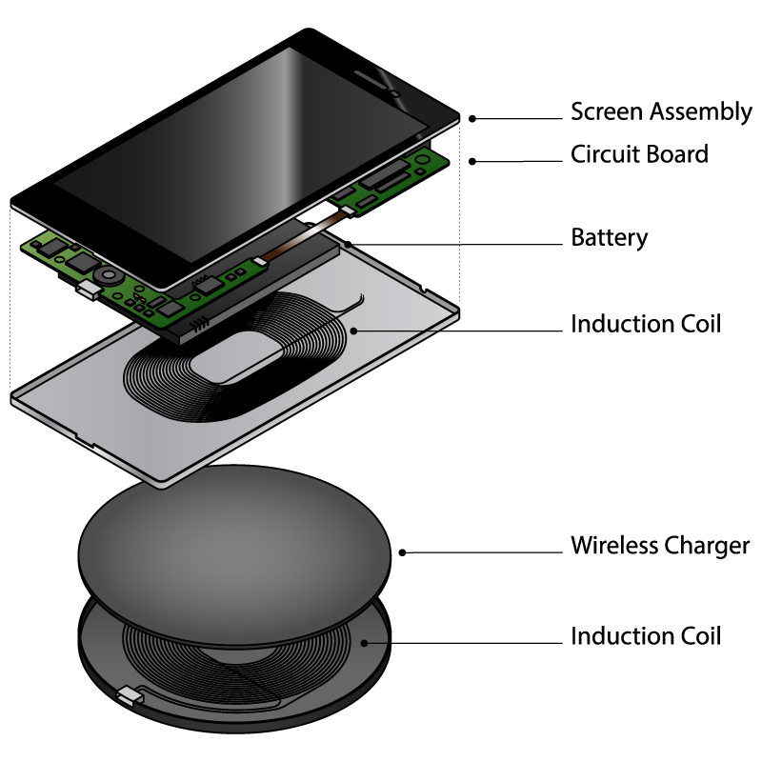
Wireless Charger:

Slide 10
ADVANTAGES :
Wiring charging can also reduce the amount of cables and power adapters you need to have custom manufactured for your device or application.
Wireless charging can be sized to deliver 5W or 10W of energy to the battery. It can be a good solution to charge your battery.
It can also charge you battery at a fast rate depending on the size of the battery pack.
In most applications the distance between the two coils is typically 5mm. It is possible to extend that range to at least 35mm.

Slide 11
APPLICATIONS:
Mobile charging – Available on Nokia Lumia (820,920),
LG Nexus 4 and 5,Samsung Galaxy S4, SONY Xperia etc.
Laptop charging – Intel and Samsung plan to launch Qi
inductive charging for Laptops in 2014.
Electric Vechicles

Slide 12
Conclusion :
Wireless power systems are constantly evolving as more
And more practical options for conveniently charging
Smartphones and other mobile devices. User experience
Is the key factor that drives technology development,
Paving the way for safer and more convenient devices
Accompanying us in everyday life.

Slide 13


